Slide 1
Homework 8 Presentation
Mitchell Wendt, CSE2122, Ankita Sikdar, 7/26/16

Slide 2
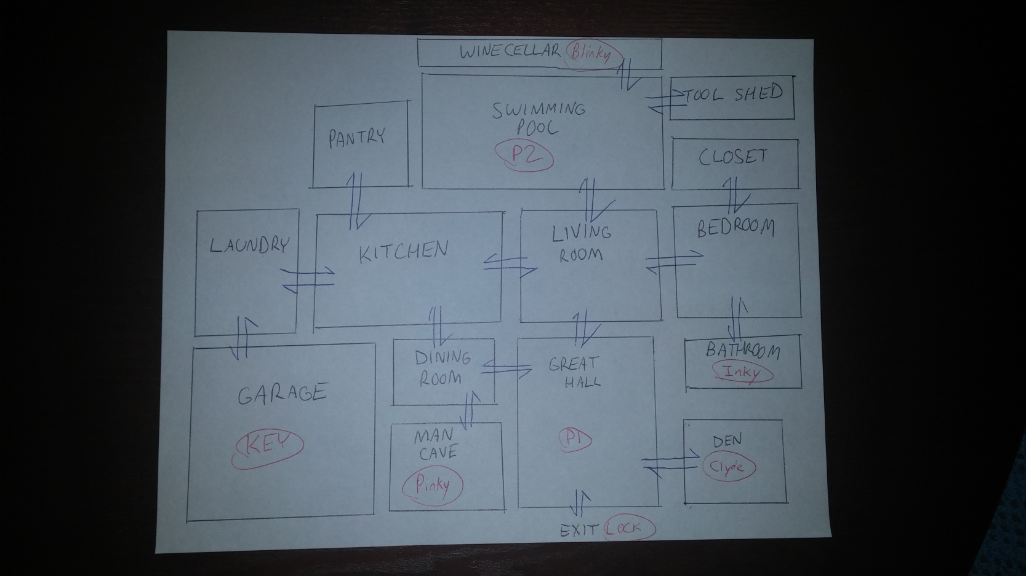
The Maze
Player 1 starts in the “Great Hall”
Player 2 starts at the “Swimming Pool”
Maze consists of 17 rooms total (15 normal rooms, 1 room that indicates the exit, and 1 dummy room “empty” that cannot be entered)

Slide 3
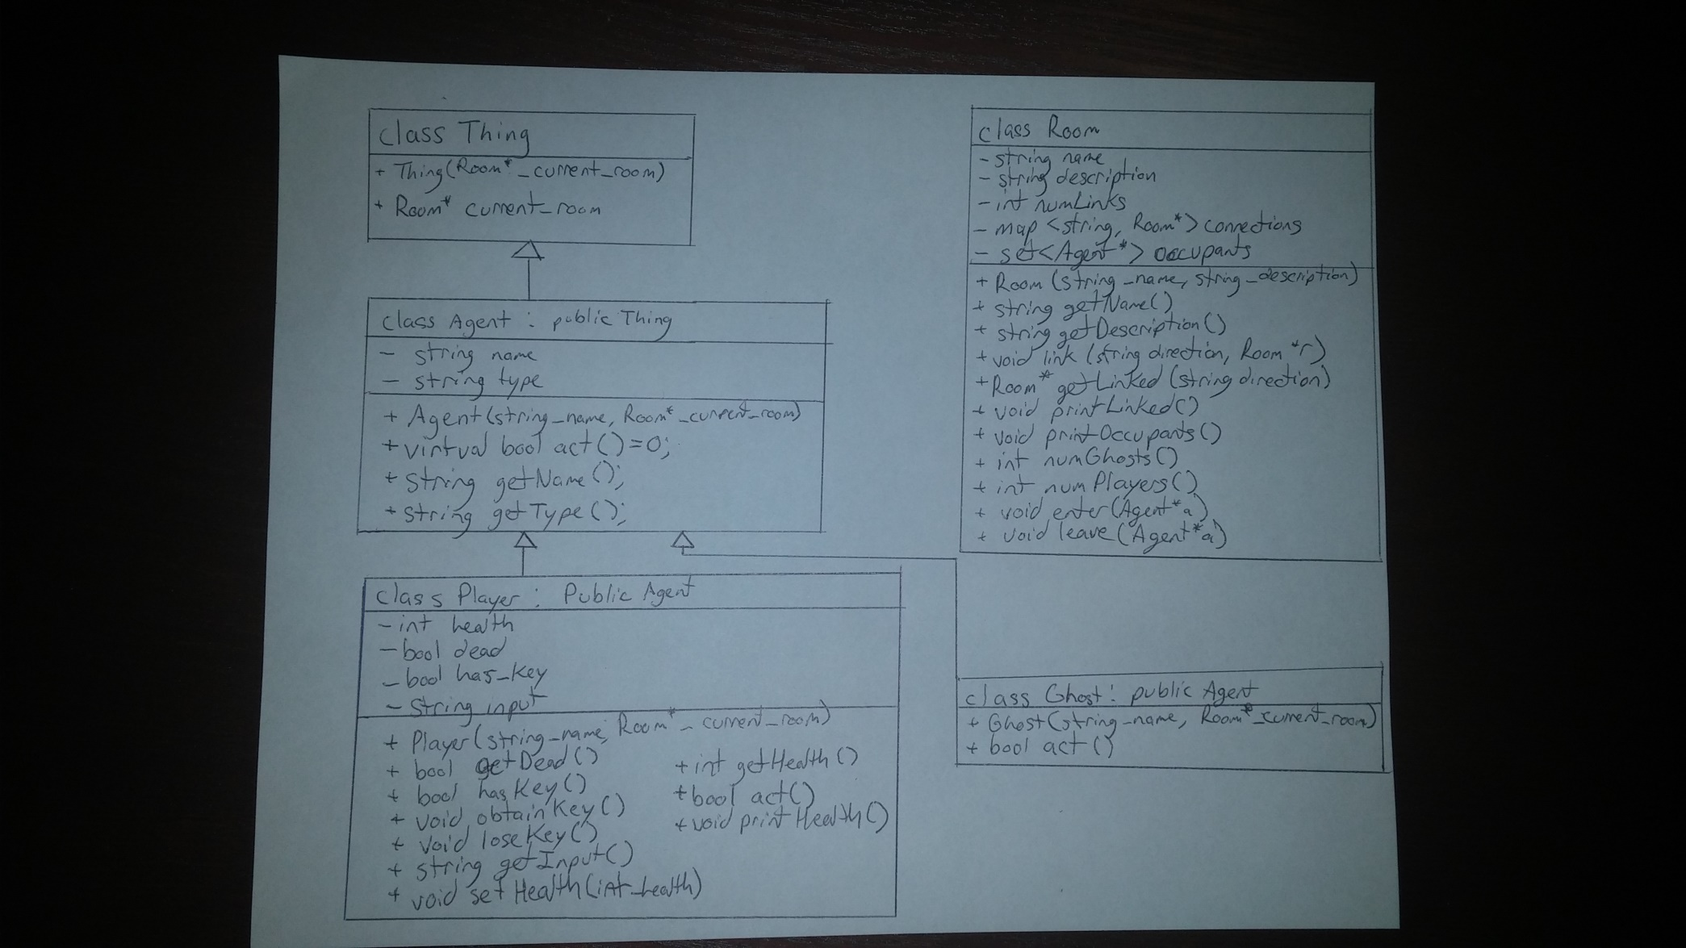
UML Diagram

Slide 4
Game Info (Number of Players, Enemies, Lock and Key, Winning Strategy)
There are 2 players in the game (Users can enter their names)
There are 4 Enemies in the Game called ghosts. Their names are Blinky, Inky, Pinky, and Clyde (names from Pacman, by Namco Ltd.)
The Lock is located in the “Garage” inside of a car, while the key is located in the South exit of the “Great Hall”
Users each have 10 health, ghosts have no health (cannot be defeated). Ghosts will move in random rooms, while users will take turns moving. Users will lose 1 health each time they enter a room with a ghost in it, and regain 3 health each time they enter a room with the other player. If one player dies (health goes to 0), the other player will continue to play but cannot regain health. If the player that dies is holding the key, the key will remain in the room that the player died in until the other player picks the key up. A player wins if they go through the locked door before the other player. The game structure makes for interesting interactions between the two players, as cooperating and moving together will increase everyone’s health, yet one player must eventually take the key and win. Of course, if both players die, nobody wins the game. Also, players are discouraged from searching too often for the key as searching for the key takes an extra turn (which makes sense, as this takes time in real life).

Slide 5
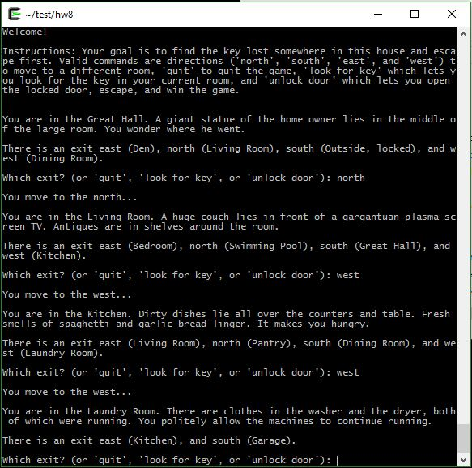
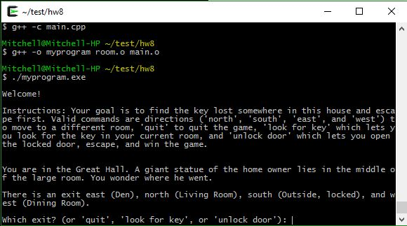
What has been accomplished
Part 1 was completed on 7/24/16 (Sunday). The maze was made and 1 player could successfully navigate the maze (see screenshots of the terminal below):

Slide 6
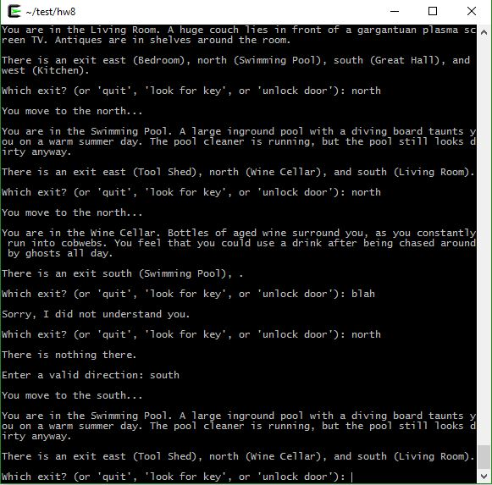
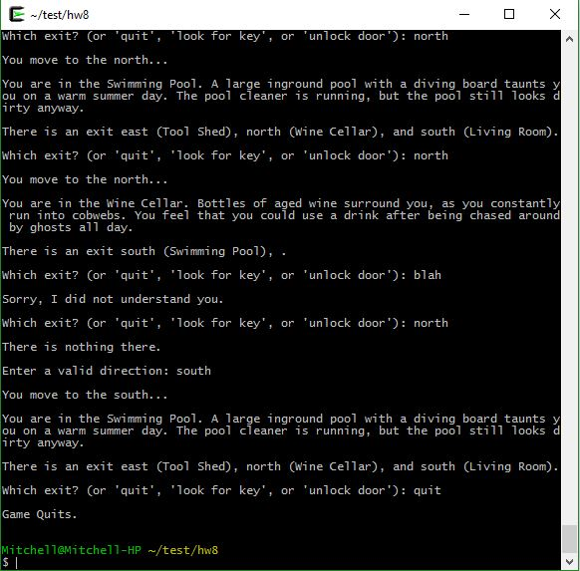
Some more screenshots
Part 2 is still under development:
What is finished: The maze from before, random movements of the ghosts, the 2 player turn based system, and placement of the players, the ghosts, and the lock and key. All files are made and somewhat finished

Slide 7
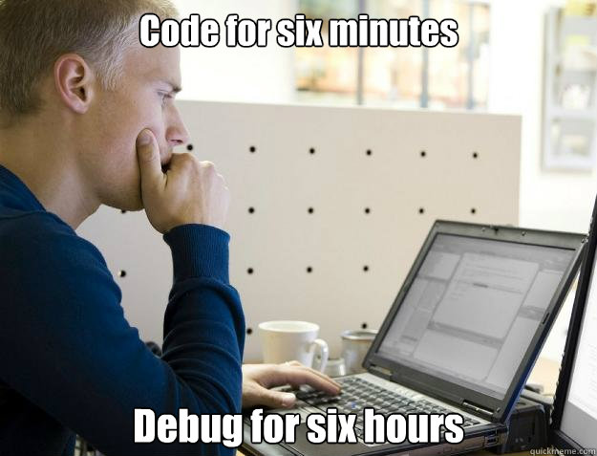
Remaining Problems to Solve
Lots and lots of debugging!
All parts are written, but now need to be finessed
Some files aren’t compiling yet (new files, main.cpp)

Slide 8
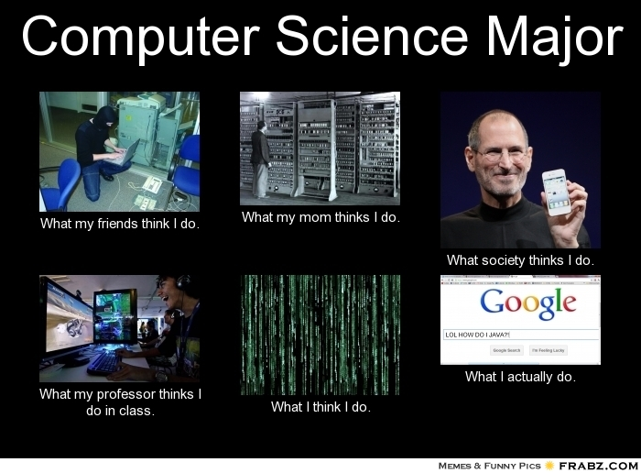
Any Questions?

